Slide 1
NH Youth SBIRT Initiative Follow-Up Practices Webinar
Friday, March 24th
12:30-1:30 PM

Slide 2
Agenda
Overview of “Follow Up”
2016 Year-end assessment: Aggregated responses
Deeper Dive: Individual practice sites follow up management strategies
Sharing Strategies and Discussion

Slide 3
Definition of Follow-up
“Follow Up” refers to any contact with a patient that closes the loop with the primary care practice.
positive screen
proactive outreach
protocols

Slide 4
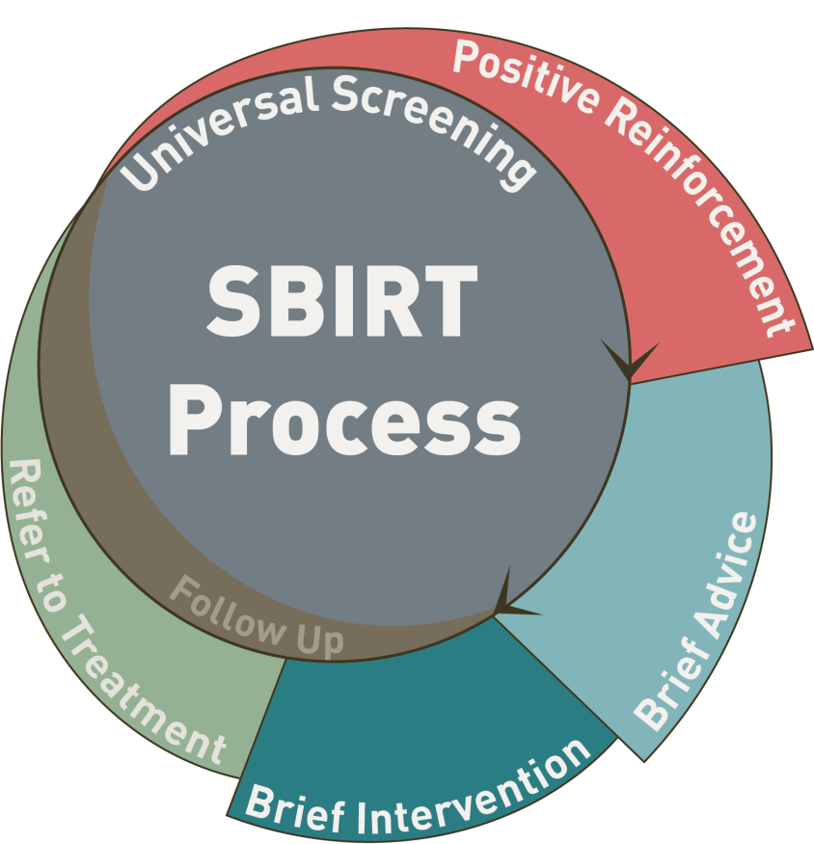
Referral to Treatment
A well-planned process through which a healthcare professional provides an active referral to behavioral health resources…within or outside of the provider’s organization for evaluation and diagnosis

Slide 5
Recommended Approach to Following Up
Identify patients need to be followed up, for what, and by whom.
Determine how you will follow up
Ensure referrals can be tracked in your system.

Slide 6
2016 Year-end assessment: Aggregated responses

Slide 7
Results from 2016 Year End Assessment
January 9th to March 3rd, 2017
35-item survey to all grantees
assess the status of S•BI•RT implementation among practice sites,
document lessons learned, and
identify common issues across practice sites to focus technical assistance for the remainder of the initiative.
Data re93% of sites

Slide 8
Activities or mechanisms that support referral to treatment

Slide 9
Relationships and Partnerships
69% of implementers have developed new relationships or partnerships with other organizations related to S∙BI∙RT. These organizations include:
Student Assistance Program (SAP’s) Counselors
Behavioral Health Providers
Treatment Centers
Internal Behavioral Health Providers
Other PCP offices

Slide 10
Follow up Protocols

Slide 11
Follow Up Protocols
EHR Support
Registry
Follow up appointments and patient alerts in the EHR
Positive screens are pulled up in a recall report to determine if follow up has taken place
Chart “Plan” documentation protocols and referral tracking in EHR
Depending on intervention needed, follow up 1 month initially
We have a guideline for identification and management of perinatal SUD.
Still working on this.

Slide 12
How follow-up action is documented in the EHR

Slide 13
Deeper Dive: How do individual practice sites manage follow-up?

Slide 14
General Issues Related to F/U
Dependent on:
Diagnosis
Some diagnoses (e.g., TB or lead) have protocols in place
Risk to the Public/Patient (e.g., highly contagious disease or poisoning)
Capacity of the patient/family
Provider preferences/variation within a practice

Slide 15
Who is doing follow-up?
General Response: Most of the time follow up is done with MA, nurse or front desk staff by phone, and by letter.
In some cases, care coordinators are providing more intense follow-up.
SBIRT Response: Depending on risk level and readiness, the follow up is largely done at the next visit.

Slide 16
How do practices close-the-loop?
For both General and SBIRT
Referrals are sent through EHR or
Referring provider’s practice sends information to specialist by phone, fax or letter
Staff (including MA or nurse) provides information for patient to follow up the end of visit

Slide 17
Where are practices tracking referrals?
Referrals are entered in EHR to where they are sent
In integrated health systems client files are shared so status is updated automatically

Slide 18
Barriers and challenges
Practice level
Patient/Family
Specialists/Partners

Slide 19
Barriers and Challenges
Practice -level
Lack of time and other resources
Workforce shortage
Increased acuity with patients (decrease provider productivity)
Time spent to track and reschedule no shows
Variation in provider preferences/practices
Lack of protocols
Stigma [“EHR is forever”]
Data re: referrals in phone notes or narrative –difficult to track
Lack of mechanism to note if patient is already in treatment or declined referral

Slide 20
Barriers and Challenges
Patient/Family
Lack of Readiness/adherence
Patients fail to follow through with referral
Not the same pressure to F/U as when need meds
Communication
Phone numbers change/get shut off

Slide 21
Barriers and Challenges: Specialists/Partners
Shortage of resources to refer for high-intensity therapy
Protocols vary by organization/agency
Some small specialist practices don’t have staff or EHR
Some specialists only close loop on initial visit, but not if ongoing relationship
HIPAA/42 CFR Part A – privacy protection vs. continuity of care
Mental Health/Behavioral Health “entirely different system …you never know what MH is up to with patients, like you do with cardiology, for example”
Burden is on PCP to close the loop on referrals

Slide 22
Enablers and facilitators
EHR
Staffing Strategies
Protocols in Place
Strong Standing Relationships

Slide 23
Enablers/Facilitators: EHR
Shared EHR:
In integrated practices – all clinicians can access patient records
With external providers
For documenting/tracking
Automatic provider reminders
“Expired order” when patient doesn’t show up
Set reminders after 2-3 months to F/U

Slide 24
Enablers/Facilitators: Staffing strategies
Team-based care
PCP/MA dyad
Maximize roles/scope of work
Care coordinators
Community Health Workers
Referral Coordinators
Referral Clinics
School-based clinicians

Slide 25
Enablers/Facilitators: Protocols in Place
E.g., For sick child visits, RN calls 48 hrs later to check on pt
Phone f/u
Catch “Missed opportunities” at subsequent visits
Referral coordinators follow up directly with patient
Phone call/letter/certified letter
Staff member at desk with patient needing referral asks patient to call specialist
Referral specialists receive electronic message – all docs exchanged (consultant report, quality report, outstanding referrals
Call patients to remind about appointments the day before
Warm hand-offs/same visit
Asking BH (referred to) to contact patient
Internal: BH Consultants outreach after 2 weeks
“high risk patients usually make arrangements to allow communication”
With some conditions, patients need meds refilled or school health forms, so built in mechanism to keep n touch

Slide 26
Enablers/Facilitators: Strong standing relationships
With patients
With partner organizations (referrals)

Slide 27
Sharing Strategies
What are ways your practice is working to increase compliance with follow-up appointments?
How is your practice closing the loop on referrals and F/U?
How do you increase your patients’ engagement in their care?
How does your practice deal with confidentiality in regard to follow-up?
How does your practice get information from phone notes?

Slide 28
Thank you!

Slide 29
Discussion
Health First – Visit Preplanning Protocol
Weeks – Referral Clinic
Concord – Patient Portal

Slide 30
Q1: How do you currently follow-up when screening indicates a patient is at risk for a particular condition, for example, hearing loss, obesity, lead contamination? [Check all that apply]
can put reminder to self (MA or RN) to f/u in EMR at set time, and it pops up | MCHC
rooming staff to f/u appointment and they will talk to patient about it. | Weeks
Orders for test, use a note in file – it depends on the issue and severity. They may tell the parents they will call to check in. If patient doesn’t follow thru on order – provider gets a note that says the order is expired. This prompts the MA to call parents to say they need to follow up. They keep the provider in the loop w response. | DH Concord
if here, CDE and nutritionist offer on-site referral right away also they will do outreach by phone. | Goodwin
provider schedule appointment and MA or nurse gives them a call, letters reminder follow-up | H1st

Slide 31
Q2:How do you currently follow-up when tests indicate a patient has a particular condition, for example, diabetes, tuberculosis, developmental delays? [Check all that apply]
MA is assigned to PCP: dyad MA does the screenings, documents results in HER, and PCP can f/u in real time during that appt | Midstate
For both questions 1 and 2: it depends. After he sees the pt, a BPA alerts him to put note in HER for family to schedule f/u on their way out, so that it is done before they leave, documents in narrative If they don’t show, secretaries may call Do a lot of f/u by phone by nurse, eg, blood tests For sick child visits, RN calls 48 hrs later to check on pt | DH-Manch
can put reminder to self (MA or RN) to f/u in EMR at set time, and it pops up | MCHC
depends on provider call | Weeks
Decision is made w provider as to who is to follow up w patient– PCP, specialist, nurse or MA. Depending on condition, child and parent (lots of judgment calls) on what to do. We use recalls and reminders as prompts, but parents must follow through. They try to catch missed opportunities at subsequent visits. Parents who really lack follow through – do not return to DH – they go to urgent care. Medically fragile kids have care coordinators assigned and have a safety net. But parent involve is critical. | DH- Concord
n testing lab, referral to specialist | Goodwin
Referral to a specialist, and nurse let’s patient know | HF

Slide 32
Q3: If you cannot reach the patient/parent/guardian with this information by phone the first time, what do you do next?
Depends on situation: stopped phone calls, too burdensome for staff—change numbers, not working, no answer—so send letter, may or may not be certified | Midstate
Depends on urgency | DH-Manch
2-3 phone calls and then a letter, which may or may not be certified depending on situation; transient population; if letter comes back, it is scanned into EMR | MCHC
depends on provider | Weeks
Certified letters are different – in general send a letter after no show and first phone call. If provider is really concerned and things are not happening – then send a certified letter but it is not standard protocol. Medically fragile pats get certified letters. | D-H Concord
– determing normal lab, letter, abnormal, outreach with phone 2 calls with letter. Depending if on condition, by receive certified letter, ie. positive tuberculosis. | Goodwin

Slide 33
Q4: How do you currently follow-up when you refer a patient to a specialist? [Check all that apply]
internal referrals can be tracked in the HER as part of patient’s record | DH-Leb
Referral is tracked electronically, set a reminder in 2-3 months to f/u HER flags if a report has not come back from specialists Then they call specialist If specialist says pt was no show, MA calls family | Midstate
Medical specialists are pretty straightforward. There has to be an order for a specialist in the HER, so there is a feedback loop with the secretaries to “close” the referral (up to 6 months open) to determine if patient went to appointment or not | Dh_Manch
referrals go to the referral coordinator; provider can click a box to order the referral and the referral co-ord can click a box that the referral was made; referral coord, who is not a nurse, reviews referrals made and reaches out to patient to see if patient made an appointment | MCH
referral clinics – Nurse or MA, referral the referral clinics will check in with the specialist after two weeks. Referral clinic is the one to f/u | Weeks
specialist faxes or via HER medical notes. If patient comes back and we do not have the records, we call. No active management to ensure the notes comes back. Referrals to specialist do not expire. The specialist usually calls to follow up on patients who do not follow through with the order. | DH-Concord
staff member at desk with patient, asks patient to call specialist | Goodwin
all referral specialists are sent an electronic message, - it all is done electronically - consultant report, Quality report, outstanding referrals, gone to specialist, | HF

Slide 34
Q5: How often do you get information from the specialist regarding the visit? Including if the patient did not show up?
Get info from Medical Specialists (most of the time) | DH Leb
Usually get information back on kids referred to medical specialists, depends on issue, eg, referred for rash, it went away, they may not hear | Midstate
Medical specialists almost always send some kind of report about visit, but no information comes back beyond that. So if pt starts to see outside specialist more routinely, eg, cardiology in Boston, only get information about initial referred visit, not anything after that | DH-Manch
use a lot of the same specialists routinely, most will let us know if the patient didn’t show up; most of the time get a report from the specialist about the visit | MCHC
Some specialist are connected with EHR and referral is done electronically | Weeks
depends on the specialist, specialist follows up w provider, nurse or receptionist. Some providers put notes in the HER to remind them to track patient. | DH-Concord

Slide 35
Q6: How do you document that you have been in contact with the specialist?
phone note, report from specialist is scanned into HER, medical records alerts MA/PCP that it is there so they can f/u | Midstate
Phone note, records scanned in | MCHC
Depending on condition and patient, we use letter, EHR notes, and phone calls. | Concord Dh

Slide 36
Q7: In general, how are follow-ups handled within your practice? For at risk? For a diagnosis of a new condition? Closing the loop with specialists? What are the barriers to more effective follow-up?
It depends on the condition, the urgency of treatment, and the motivation of parents. For example, there is a protocol for lead poisoning in which the RN contacts the parents by phone and/or letter, orders repeat labs and medications, and arranges for f/u as needed. But they have to leave it up to the family to actually do the repeat lab and get the meds. She can put a tickler in her own file to pop up in a set period of time to check to see what happened, but there is no system to remind the family. ADHA has an automatic f/u in 6 months, but patients often don’t make the appointment until they need med refills. With kids identified as developmentally delays, there is a protocol to make sure they got to the specialist to which they were referred. There is usually no problem with f/u for these are most parents are motivated to get to the appointment. There are differences between internal v. external specialist referrals. With DH internal referrals, the notes are in the patient’s record. Closing the loop with external referrals is not as straightforward. | DH-Leb
Have a pretty good team approach to closing the loop, especially using the referral coordinator. | MCHC
Provider indicates that a referral is needed and the MA/referral clinic monitors it. At Risk, if youth want sto a BH, they can otherwise the provider will see them. Referral Clinic can get behind, if the patient refuses the referral. | Weeks
What are the barriers to more effective follow-up? Time and resources. Medically fragile pts – they que themselves, or care coordinators with a prompt called postpone reminder. Provider sends a note to MA to check on patient. Non-compliance of families – patients lack interest or ability to follow up w referrals. All we do is ask the parents, but they need to play an active role in getting kid the care. DH Concord does a pretty good job w follow up. | DH Concord
f/u receive the nursing and provider review and determine what needs to be done, update EMR. Goes to provider if new condition. At risk, nurse update chart and sends to provider. Most of the time, we get a report back from specialist, if not report sent, we follow up with a call to specialist. | Goodwin
If f/u needed, preplanning sheets from MA, sections for referral and f/u appointments, documents and patient check-outs and the staff makes the appointment. Staff calls the day before for appointment. Barriers, no show call before, no show, patient coordinator calls after the no show, reschedule. | HF

Slide 37
Q8: How do you currently follow-up when screening indicates a patient is at risk for alcohol and drug use/abuse? [Check all that apply]
Score on CRAFFT triggers internal BH referral If kid/parents say no, there is no declination code in HER Most kids who would need a referral are already known to them for other reasons and are in treatment | Midstate
depends on score, either make f/u apt on the way out of index visit or not | DH-Manch
If patient is at risk, can do WHO to internal BH right then and there; if one is not available, outreach with a f/u phone call and send request to BH consultants’ desktop to contact patient; asking CHAN (HER vendor) to put in structured field for BI | MCHC
ask the referral, decline, the provider with follow-up, if the accept the referral , sent to inhouse LADC or external referral | Weeks
inter BH warm hand off, try to get it at same visit | Goodwin
inter BH warm hand, try to get it at same visit | HF

Slide 38
Q9: How do you currently follow-up when screening indicates a patient has a problem with alcohol and drugs? [Check all that apply]
___X___Referral to a specialist—internal and external ______Other: If patient is at risk, can do WHO to internal BH right then and there; if one is not available, outreach with a f/u phone call and send request to BH consultants’ desktop to contact patient | DH Manch
provider will follow-up or referral to Shawna. – Groveton, warm transfer can be done but not at other site, too big. Twice and month | Weeks
Under – WIT system, positive – so staff/provider will do the referral and the f/u, Medicated | Goodwin
Appointment with provider, staff call a day before will call to reminder | HF

Slide 39
Q10: If you cannot reach the patient/parent/guardian with this information by phone the first time, what do you do next?
depends on patient situation, we know who most of them are anyway, following them for other reasons | DH Manch

Slide 40
Q11: How do you currently follow-up when you refer a patient to a behavioral health (BH) specialist? [Check all that apply]
Depends…With internal referrals, the notes are in the patient’s EHR, but with external referrals, there may not be f/u. There are multiple different BH providers in the area and each is different. | DH-Leb
Internal BH f/u is easy—integrated record so can see it BH staff track this Most external BH is to Mental Health Center who can document in Midstate record but they don’t, so f/u depends on client letting Midstate know that they went to the appointment, but they don’t always call to check | Midstate
For referral, they provide pt/family with a list of BH counselors in the area, some information about counseling, and pretty much leave it up to the patient/family to f/u There is no order in the record like there is with say cardiology in Boston bc insurance does not require an order for a referral from the PCP for BH, so there is nothing to track Staff can set a reminder to call patient to fu/ | DH-Manch
Depends, do a 2 wk f/u call or book an apt, BH consultant handles this, put flag in their EMR to remind them | MCHC
intake assessment and a referral provider received the assessment is complete. Go through referral clinic | Weeks
External referrals follow same process/protocols as other conditions. The families do not have the same degree of pressure to follow through w BH appointments – they will not need to go back to provider for medications or other treatment. | DH Concore
integrated health, provider to provider and case reviews every Monday, next is external BH the nurse outreach to patient or specialist. | Goodwin
if in house, walk to provider and the provider can see the file, if given permission. Outside, consultant notes electronically, PCP will call BH | HF

Slide 41
Q12: How often do you get information from the BH specialist regarding the visit? Including if the patient did not show up?
Getting information is difficult from external referrals. The patient/parent has to sign a waiver and then the issue of how to transmit the notes to the PCP comes up because of privacy/HIPAA concerns. If they get scanned into the DH record, they are there forever. (Not often) | DH-Leb
external BH does not close the loop, but their internal BH staff will try to track it (not often) | Midstate
it’s an entirely different system, never know what MH (?mental health?)is up to with patient like I do with cardiology in Boston, but again, most kids with drug/alcohol issues also have depression, anxiety, ADHD so they are already following the pt for these reasons (not often) | DH-Manch
Internal—it’s in the patient’s HER; if no show, BH consultant calls usually refer to Greater Manchester Mental Health, BH consultant calls to see if patient attended the appointment Sometimes they send a community health worker to look for patient/family if it is urgent; they also have 3 clinicians working with the schools, and can find a patient that way if they need to | MCHC
They communicate back most of the time if the parent signs consent. High risk patients usually make arrangements to allow communication | DH Concord
External, not often with an outside case review, weekly, to meet the needs of patients | Goodwin

Slide 42
Q13: How do you document that you have been in contact with the BH specialist?
instant message. With a forward of assessment. | Weeks
No different than anything else. If you don’t document – it did not happen. | DH Concord
integrated BH specialist can access patient file | Goodwin

Slide 43
Q14: In general, how are follow-ups with youth at risk for drug/alcohol problems handled within your practice? For youth with a drug/alcohol problem? Closing the loop with BH specialists? What are the barriers to more effective follow-up?
With internal BH referrals at DH, the common HER makes it easier to keep track, and the BH specialists are able to do a lot of the f/u once a referral has been made to them. External referrals are much more difficult for f/u. There are multiple BH providers, and some of the smaller ones don’t have EHRs or staff. Some BH providers are more forthcoming than others. The PCP can’t make the patients come back to the PCP for f/u, or require that BH providers keep them in the loop. And there is no carrot or stick like with other conditions. For example, with other conditions, patients need med refills or school forms to be completed and so they have to keep in touch with the PCP office about their progress. Substance use isn’t like that. There is nothing the PCP can do. PCP can control what is in her own practice but if patients don’t take her calls or refuse treatment, she can’t do anything about it. While we are de-stigmatizing BH to make treatment and f/u easier, there is still a lot of work to do about privacy concerns, especially when the EHR is forever. | DH Leb
How do you define f/u? that determines any codes you would develop/use for data capture Say had BI in index appointment, would then f/u with next routine visit, not a separate visit But if patient declines treatment or any other f/u, no way to document it, or that they are already in treatment What is the expectation in primary care for f/u? Kids may not be open to discussion on first round of questioning about drugs, etc, but with time, as it becomes routine, they may open up more. [Documentation, Lack of Readiness (patient)] | Midstate
The Behavioral Health Consultants/Clinicians handle all the BH referrals and f/u, but there is no easy way to pull the data because it is in phone notes or other narratives. | MCHC
Provider sees them and the risk the provider will do the intervention, if needed the referral can be done, otherwise it stays with the provider. Challenge – f/u visits do they keep doing it? Met that goal, what do we do now? Patient – screening, checking up the SBIRT how do we alert the provider, if f/u, | Weeks
Handled the same way as the adult pop, however, hired a nurse with handle not currently in the program. Have to be 17 to get an MP. 42 CFR – continuity of care, so protective of the patient – both youth and adult Also the work force shortage, higher level of the care is tough until they can into somewhere. The providers end up with one patient vs. 2 patients | Goodwin
No internal referrals. All referrals are to resources in the community. In general a lack of services for youth in community. Providers are keyed in to what is going w patients, but they struggle to find resources. Providers are not aware new treatment program at Riverbend. BH are good about following up w providers if they see the patient and the patient’s signs consent. | Concord DH
Again, provider indicates with f/u. Adult worked well and they tried it with the youth and it seems to work well for them. Screening 95% and | HF

